Slide 1
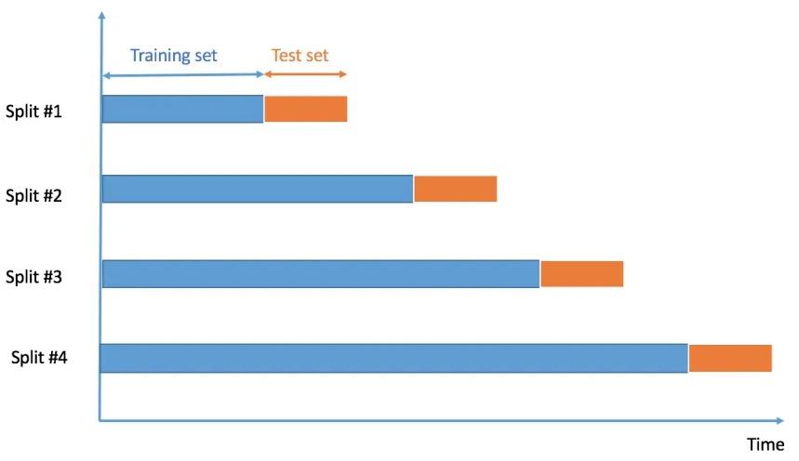
Cross Validation
1.Time Series Cross Validation

Slide 2
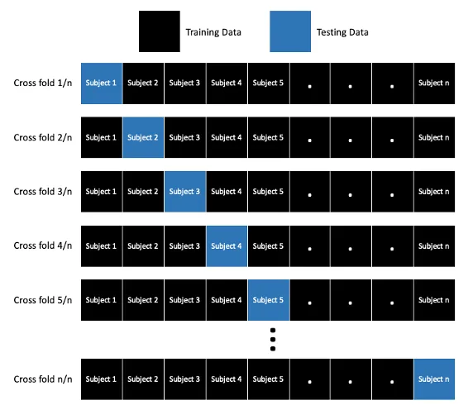
2. Leave One Out Cross Validation

